Slide 1
Thesis Fair Semester 1 2012
Russel Pears

Slide 2
Broad Areas of Interest
Machine Learning and Data Mining
Financial Data Modelling
Data Warehousing

Slide 3
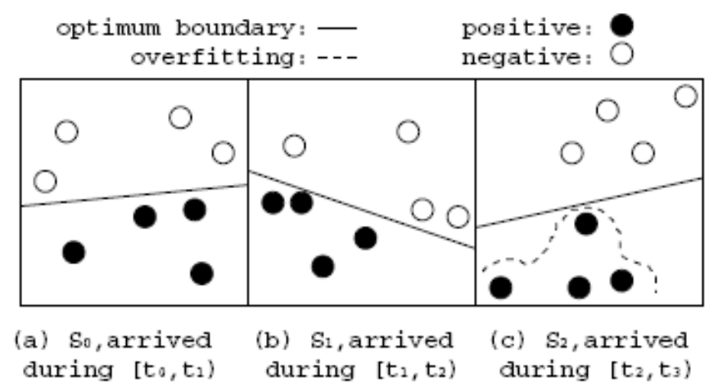
Mining High Speed Data Streams
Papers:
Hoeglinger S and Pears R, “A Concept-based Approach to High-Speed Data Mining”, 6th International Conference on Hybrid Intelligent Systems (HIS 06'), Auckland, New Zealand, December 2006.
Hoeglinger S, Pears R, “Use of Hoeffding Trees in Mining High Speed Data Streams”, Proceedings of ICIAfs 2007, Melbourne, Australia, 2007.

Slide 4
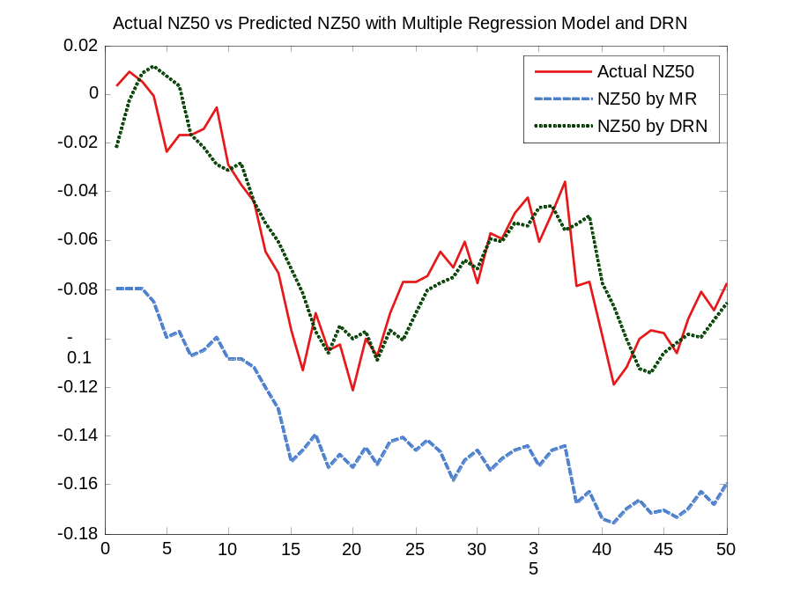
Financial Data Modelling
Objective is to build a dynamic model that predicts stock market indexes
Papers:
Widiputra H, Pears R and Kasabov N, “Dynamic Regulatory Networks for On-Line Modelling and Prediction of Multiple Stock Market Indexes and their Interaction”, Journal of Information Science, 2008 (in preparation)

Slide 5
Nature Inspired Algorithms for Classification
Many nature inspired algorithms exist, for optimisation, including genetic algorithms, ant colony optimisation, particle swarm optimisation and bacterial inspired optimisation methods
I am looking at modelling the processes by which bacteria form colonies and applying these methods to solve hard classification problems.

Slide 6
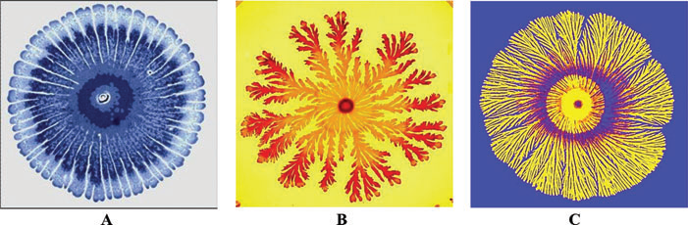
Bacterial Colonies
Engineering skills of bacteria.
(A) Typical pattern developed at higher food levels when attractive chemotactic signaling is activated.
(B) Typical pattern when food chemotaxis dominates the growth at intermediate levels of food.
(C) Colonial pattern at low level of food when repulsive chemotactic signaling is assumed to be intensified.
The colors are added to indicate the bacterial density

Slide 7
Open Questions for Research
Main Question:
Can we use a training dataset containing data from a number of classes to create a “food gradient” that will cause bacteria to swarm and discover class boundaries?
Subsidiary question(s):
  How to partition the dataset and what measure do we use to measure “food density” at each partition?
  What are the optimal settings of the bacterial search algorithm to use in order to get the best possible accuracy.
  How do bacterial inspired classification algorithms (BICA) perform on challenging classification algorithms involving highly imbalanced class distributions

Slide 8
Data Warehousing
Objective: Compress data in order to speed up OLAP queries (query optimization)
Papers
Pears R, Houliston B, “Accelerating Multi Dimensional Queries in Data Warehouses” to appear in Contemporary Issues in Database Design and Information Systems Development, Published by IGI Global Group Publishing, USA., 2008.
Pears R and Houliston B, “Optimization of Multidimensional Aggregates in Data Warehouses”, Journal of Database Management, IDEA Group Publishing, USA, 18(1), 2007.

